Slide 1
Crime and Dine
Rachel Berkowitz, Jeanette Cross, Michael Lygas, Xeniya Bogoslavskaya

Slide 2
Motivation & Hypothesis
Comparing the restaurant ratings to the US crime statistics.
We expect there not to be a correlation between the restaurant ratings and the crime statistics because there are often good eateries in bad areas.

Slide 3
Research Questions
1
Does the number of high rated restaurants in a given area correlate to the number of crimes in the area?
2
How does it differ by different types of crimes?
3
Will a dining establishment Yelp review be impacted by population metrics (i.e. a more populous area have a higher rating)?

Slide 4
Data sources
Crime data: Data.gov
An annual publication in which the FBI compiles the volume and rate of violent and property crime offenses for the nation and by state. Individual law enforcement agency data are also provided for those contributors supplying 12 months complete offense data.
Format : .csv file
https://catalog.data.gov/dataset/crime-in-the-united-states-2015

Slide 5
Data sources
Restaurant rating: Yelp.com
API: https://api.yelp.com/v3/businesses/search
Yelp documentation: https://www.yelp.com/developers/documentation/v3/business_search
Format: json
https://www.kaggle.com/uciml/restaurant-data-with-consumer-ratings - Reviewed and discarded since we were not sure about the reliability of the source. The volume did not meet the 10,000’s criteria

Slide 6
Process
Clean_crime_data.ipynb – Load crime data from data.gov
Yelp.ipynb – call Yelp API and write yelp_data.csv file
Reformat_yelp.ipny – Split county and state into separate columns and write yelp_reformat.csv
ANALYSIS01.ipynb – Analyze the data using graphs
Heatmap.ipynb – Generate heat maps
Statistics.ipynb – Statistical analysis to confirm analysis

Slide 7
Data volume
Crime data:
3,137 Counties
Yelp data:
105,640 restaurant ratings
Accessed ratings for up to 50 restaurants per county
27 counties had no restaurant ratings
Process took about 1 hour to extract data

Slide 8
Loading Crime Data

Slide 9
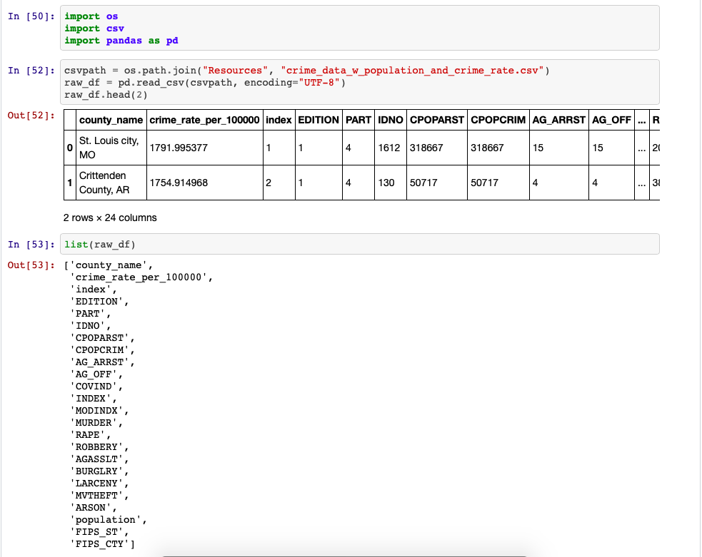
Found Crime data and started to prepare crime information. First we needed to clean the data. So we listed all the columns to determine which ones we need.

Slide 10
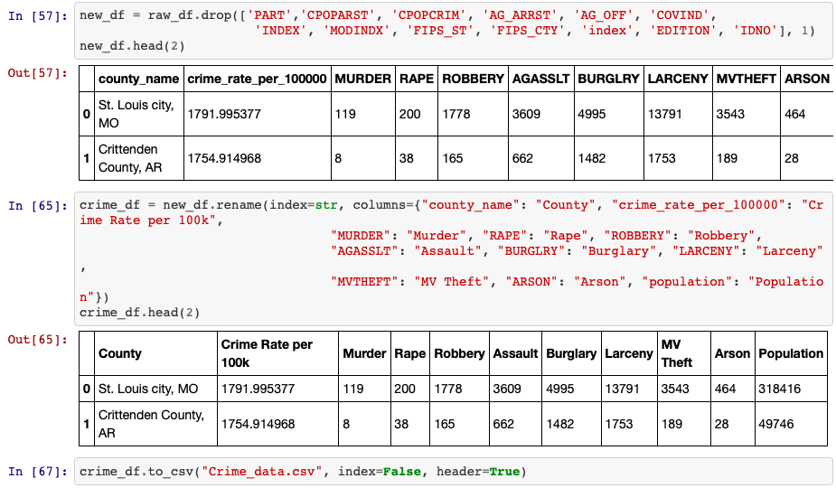
Created a new DataFrame, dropped the columns we won’t use and renamed the columns for cleaner look – converted it to csv file.

Slide 11
Loading Restaurant Rating

Slide 12
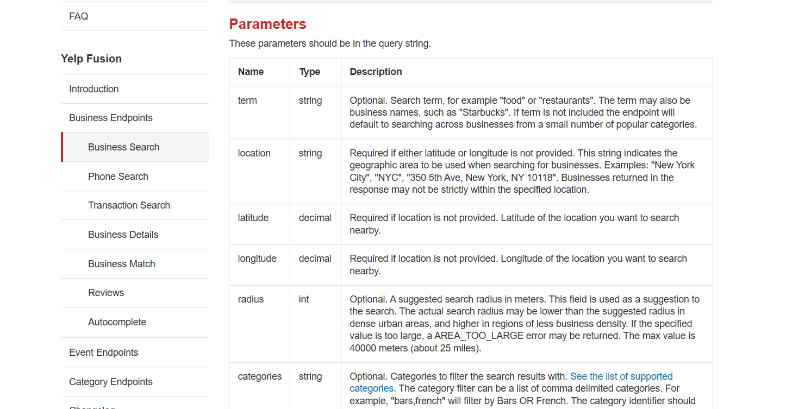
Yelp Documentation

Slide 13
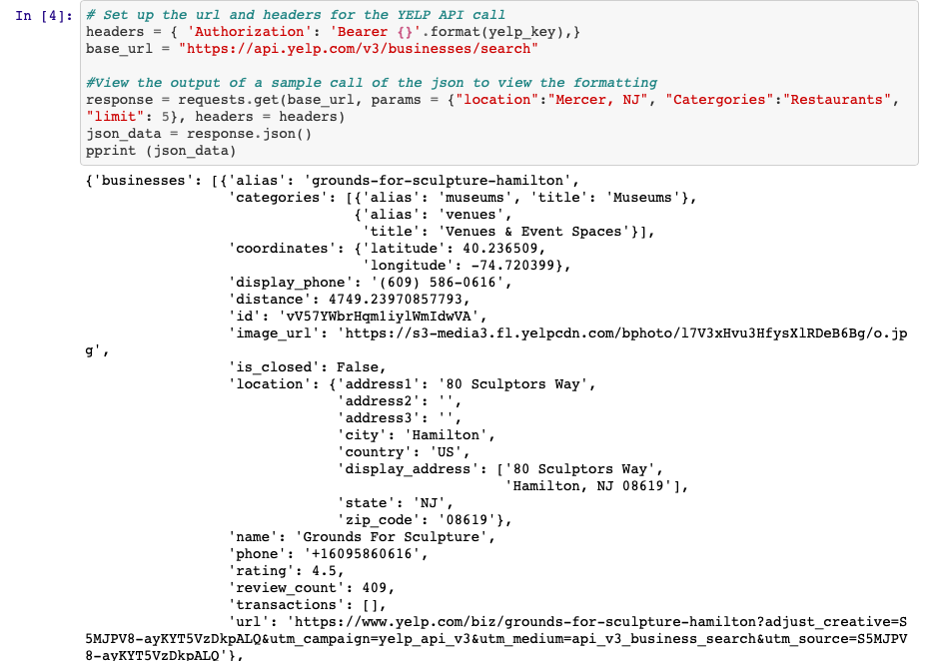
Set up Yelp URL headers for API calls

Slide 14
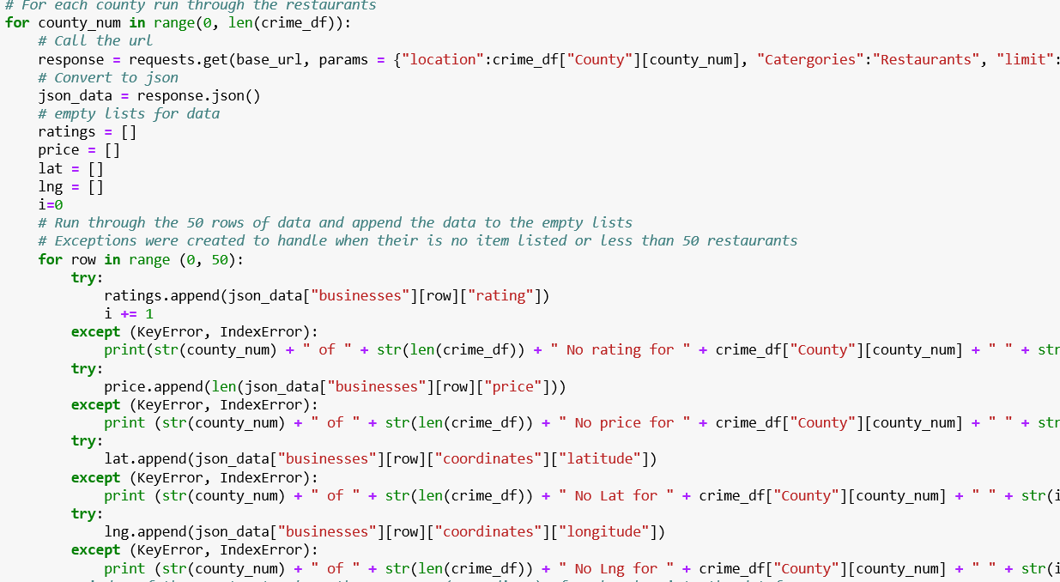
Loop through each county and retrieve 50 restaurants

Slide 15
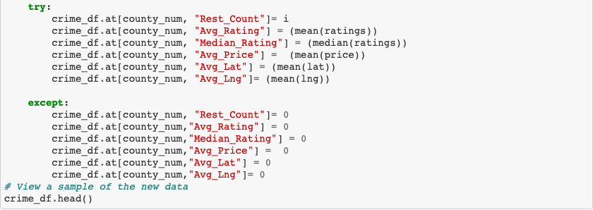
Check for errors or missing values

Slide 16
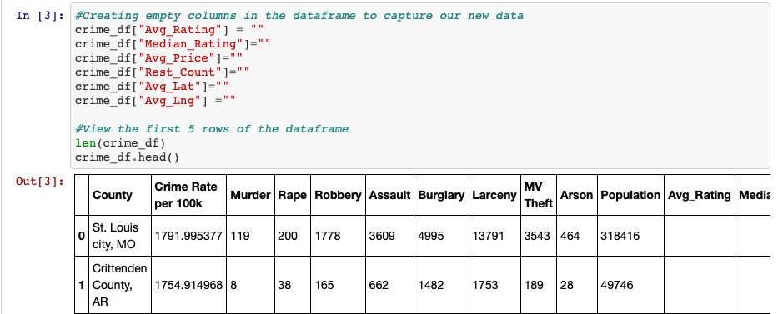
Added empty columns to capture the data we have received from crime doc.

Slide 17
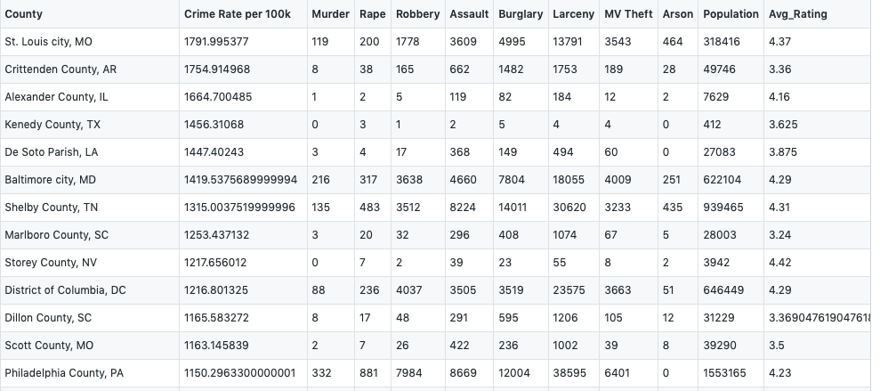
Write to CSV File

Slide 18
Lessons Learned
Crime data
Data included counties and parishes
Yelp data
5,000 limit per day
Concatenate cities when executing API to reduce calls to API
Job failed after executing for 45 minutes
Add code to display start and end time when testing for smaller volume to estimate larger tests
Add check points to restart code at failure point.

Slide 19
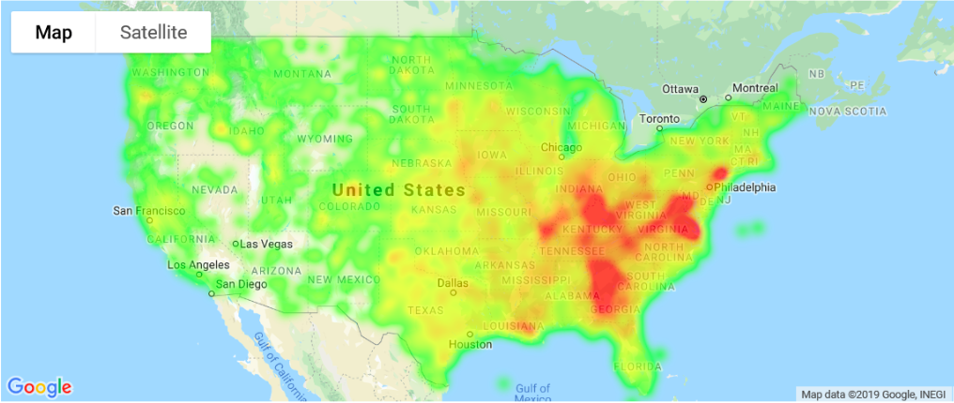
Restaurant Ratings

Slide 20
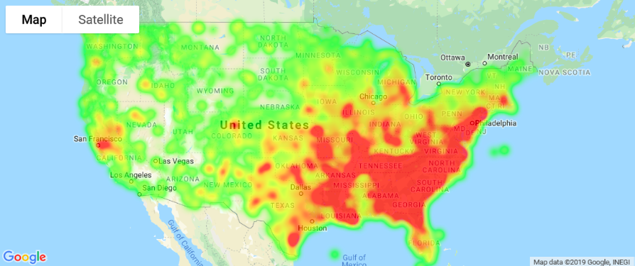
Crime Rate Heatmap

Slide 21
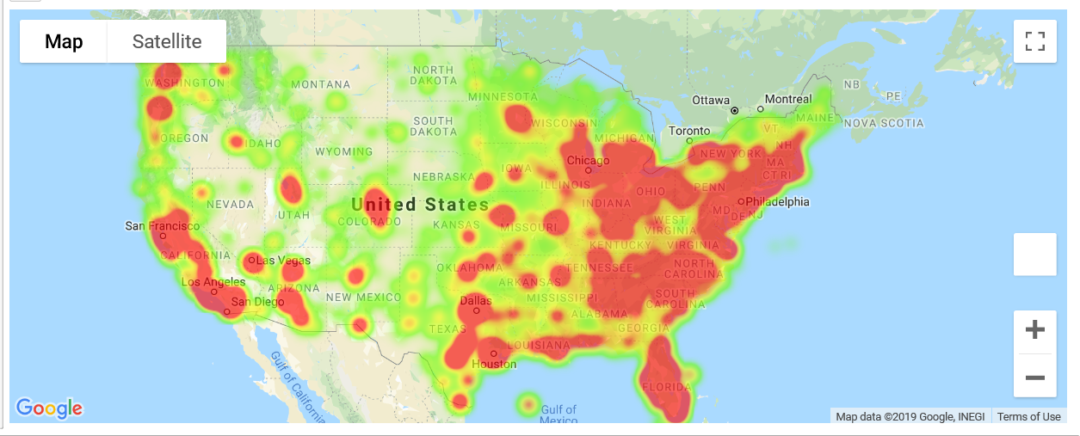
Population Heatmap

Slide 22
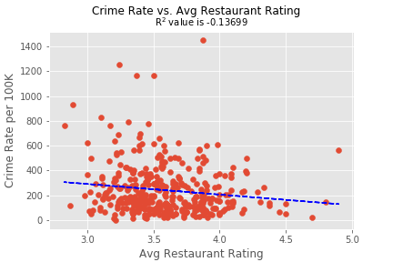
Check for Correlation between Crime (Type of Crime across US) data & Dine (Yelp Review data)

Slide 23
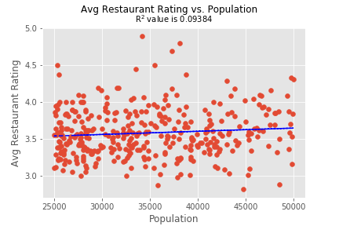
Check for Correlation between Yelp Restaurant Rating and Population

Slide 24
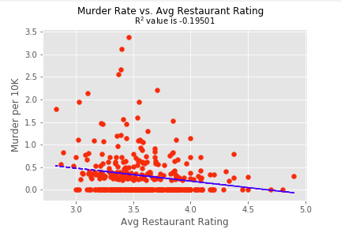
Check for Correlation between Murder and Yelp Avg Restaurant Rating

Slide 25
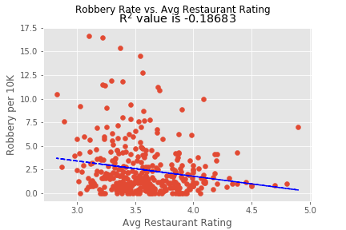
Check for Correlation between Robbery Rate and Yelp Avg Restaurant Rating

Slide 26
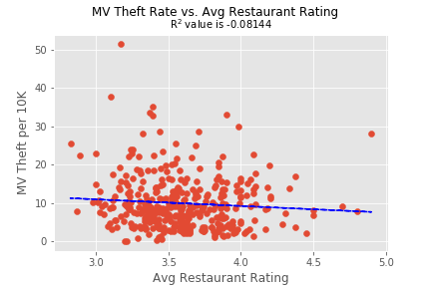
Check for Correlation between MV Theft Rate and Yelp Avg Restaurant Rating

Slide 27
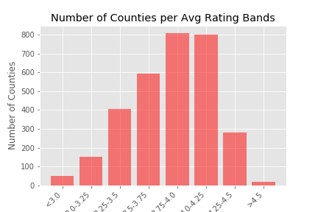
Does the Average Rating per County differ based on the number of crimes?
First we had to separate the average restaurant rating into categories from 3 – 4.5 separated by .25 ranges.

Slide 28
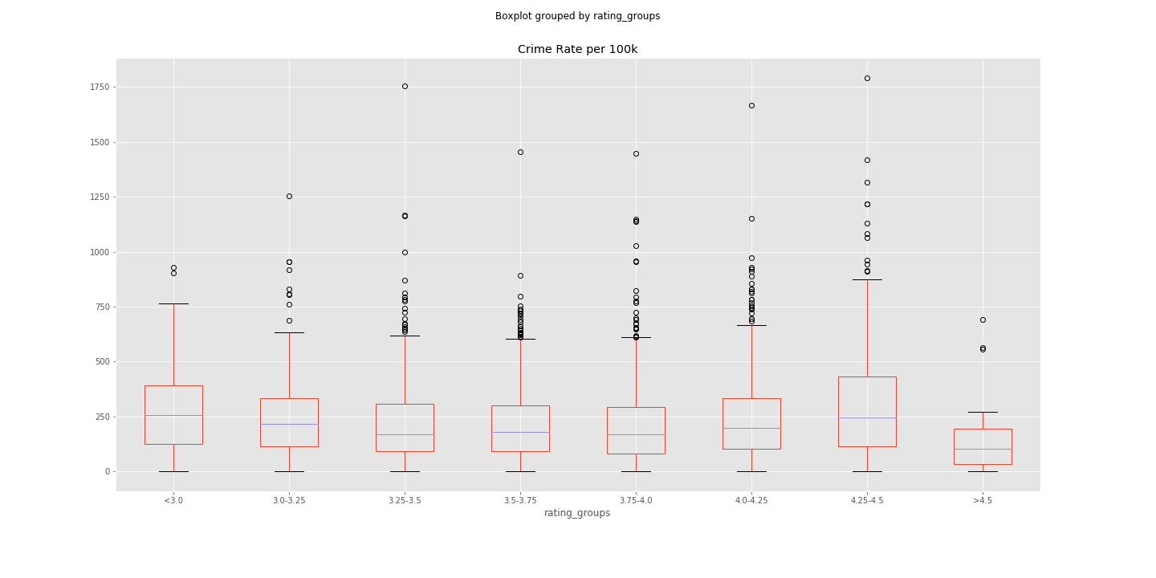
Crime Rate per 100k (Grouped by ratings)

Slide 29
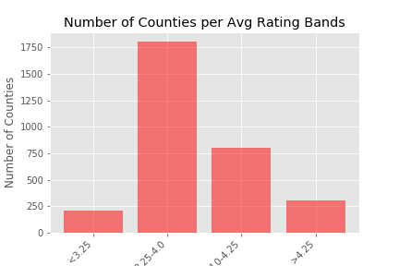

Slide 30
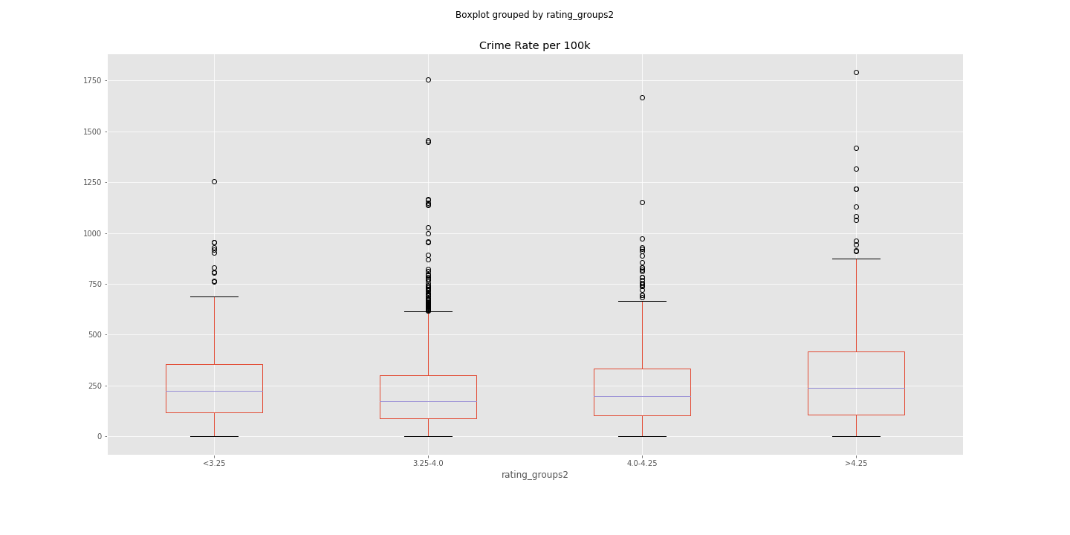
Crime Rate per 100k

Slide 31
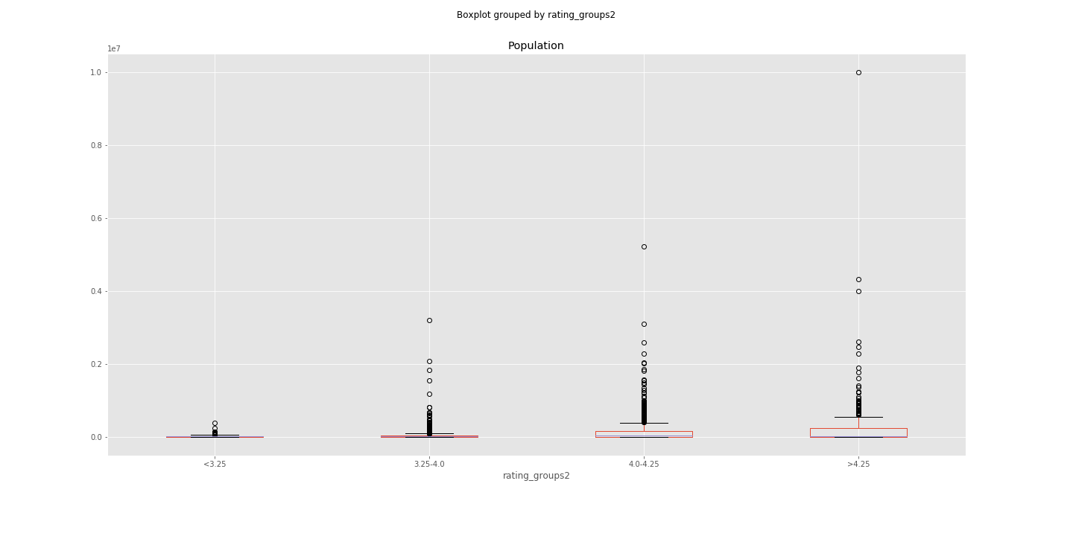
Population

Slide 32
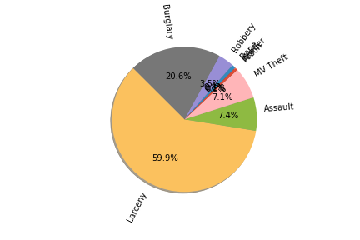
Does the type of crime differ?
With a degree of freedom of 7, and a p value of 0.5 there is a critical value of 14.07 and a Chai squared of 23109324
So we reject the null hypothesis that the types of crimes are random.
Yes! We are 95% confident that they are statistically different

Slide 33
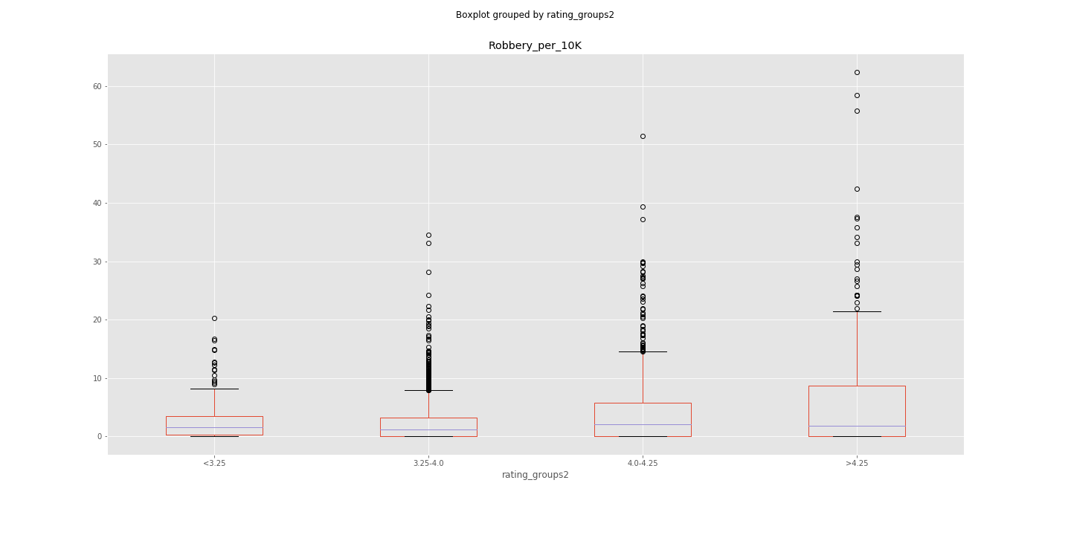
Robbery per 10k

Slide 34
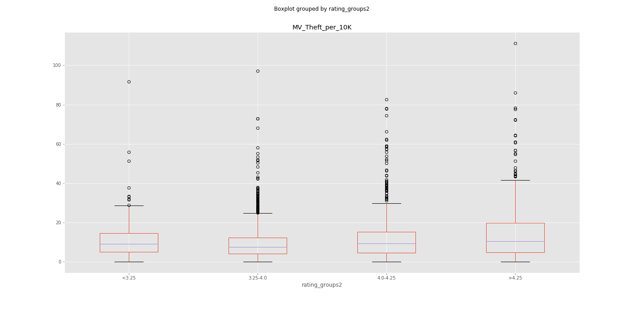
MV Theft per 10k

Slide 35
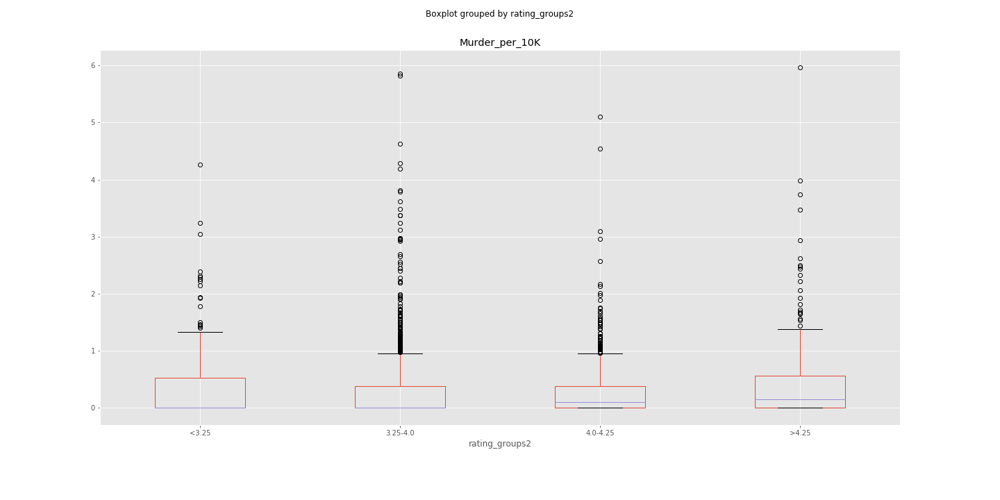
Murder per 10k

Slide 36
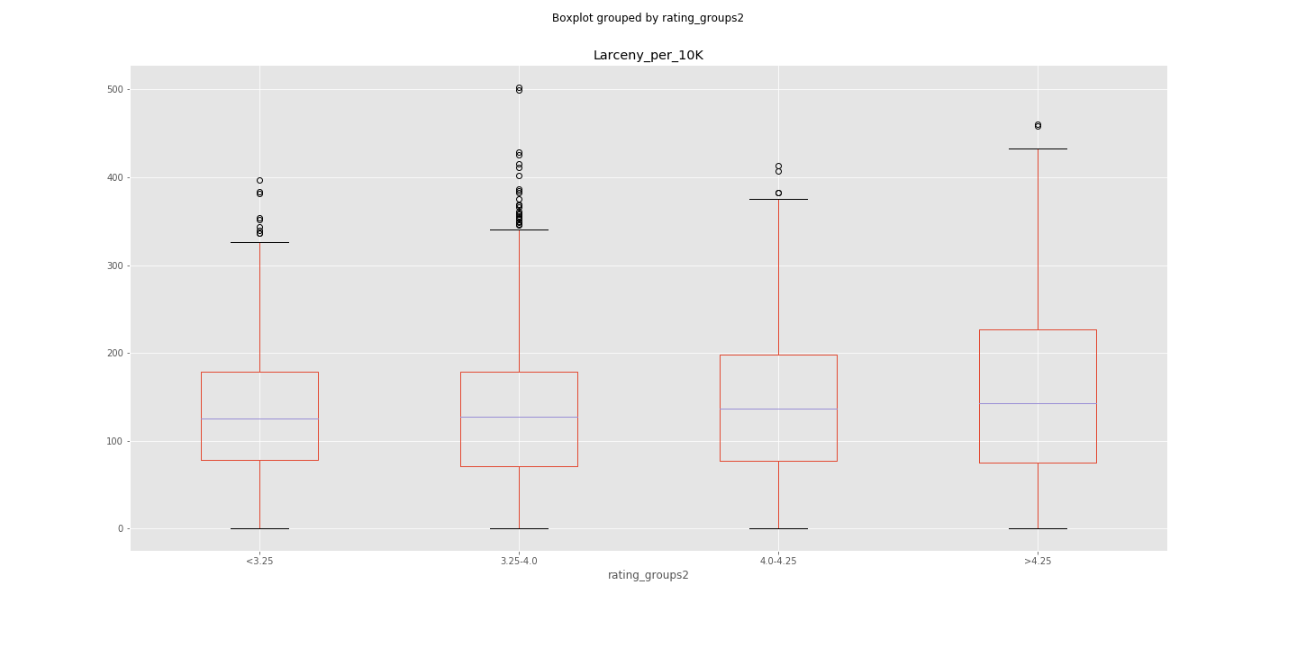
Larceny per 10k

Slide 37
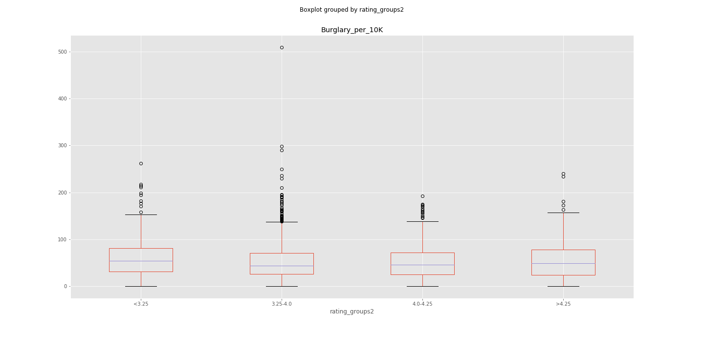
Burglary per 10k

